Slide 1


Ontology Designing Towards Effective Disease Analysis
TEAM RPM
MADHURI SARDA - 12
ROHITA GOPARAJU - 7
POONAM KANKARIYA – 8

Slide 2

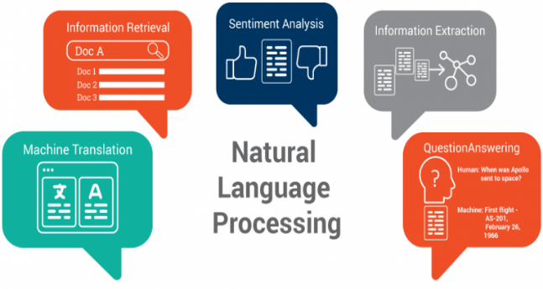
Idea
Application of Natural Language Processing (NLP) techniques on breast cancer related data
Ontology development and analysis
This Photo by Unknown Author is licensed under CC BY-SA

Slide 3

introduction
Increase in emerging diseases impact human’s well-being
Enormous availability of bio-medical data influences the study
Need for extensive study and efficient model
Knowledge growth resulting in effective disease management
This Photo by Unknown Author is licensed under CC BY-SA

Slide 4
Related work
Prototype system leveraging semantic technology towards data parsing of staging manual
Inclusion of additional biomarkers towards development of cancer staging manual

Slide 5

goal
Understanding of the disease and its components viz. causes, symptoms, treatments
Identification of classes leading to ontology creation and analysis
This Photo by Unknown Author is licensed under CC BY

Slide 6

Data
Data set
Research abstracts associated to medical domain relating specifically to cancer
Primary source of data
https://www.ieee.org/content/ieee-org/en/publications/
https://www.ncbi.nlm.nih.gov/
This Photo by Unknown Author is licensed under CC BY-NC

Slide 7

Operations performed
Sentence Tokenization
Word Tokenization
Stemming and Lemmatization
Triplets Extraction
Topic Modelling – LDA
Ontology creation – Protégé tool

Slide 8
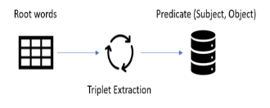
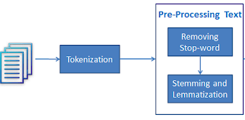
OPERATIONS – basic

Slide 9
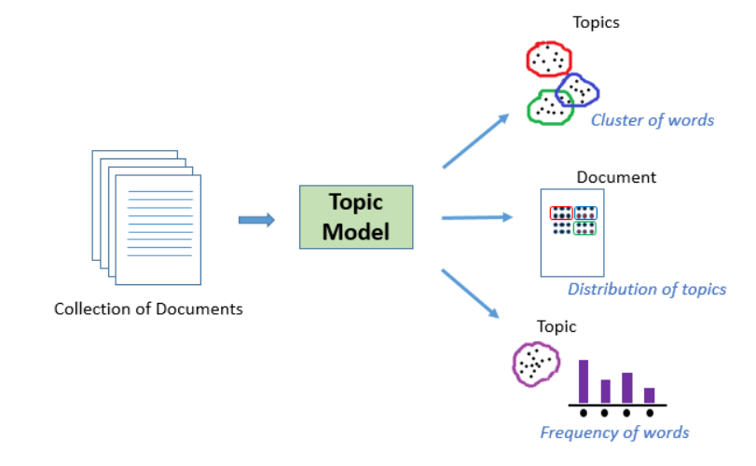
Operations – topic modelling

Slide 10

Demo

Slide 11
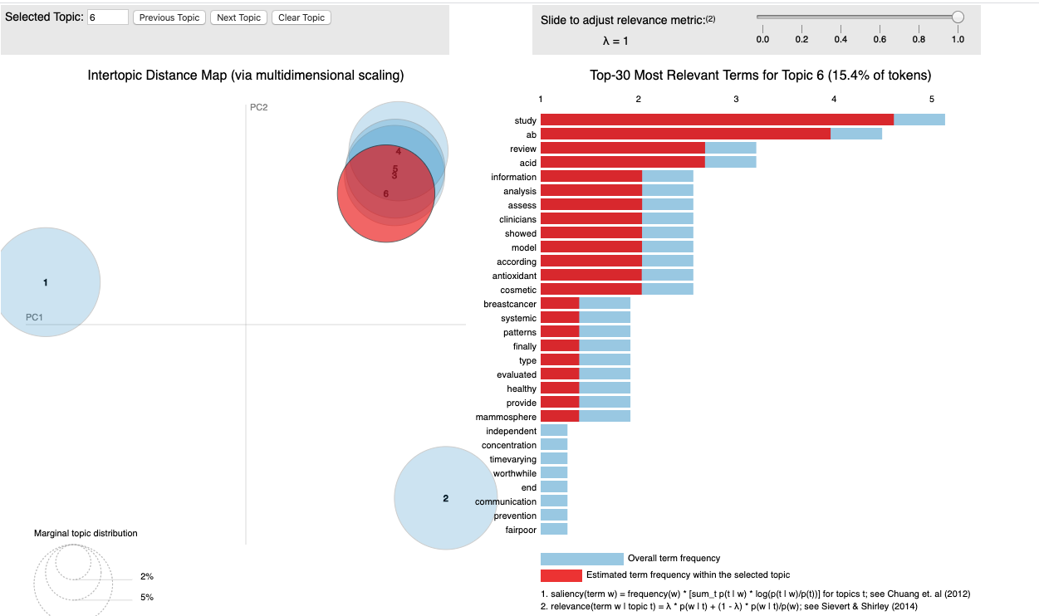
Topic modelling – 1

Slide 12
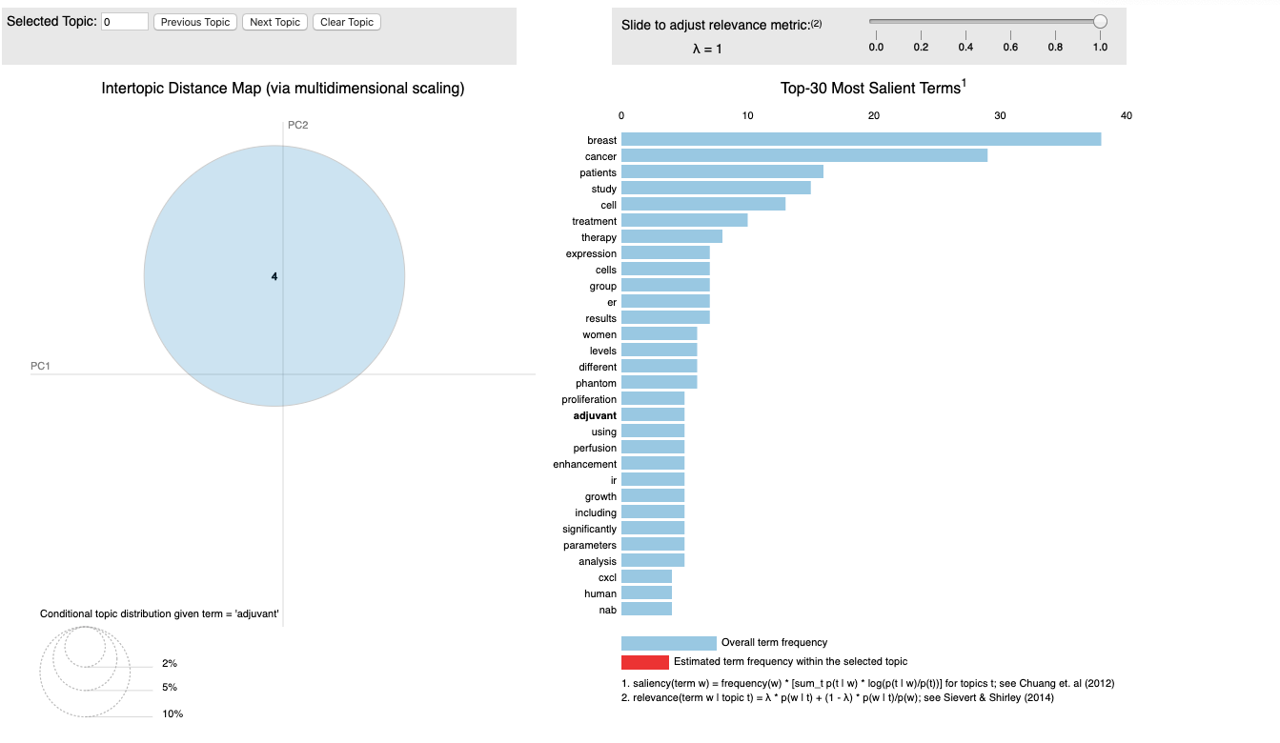
Topic modelling – 2

Slide 13
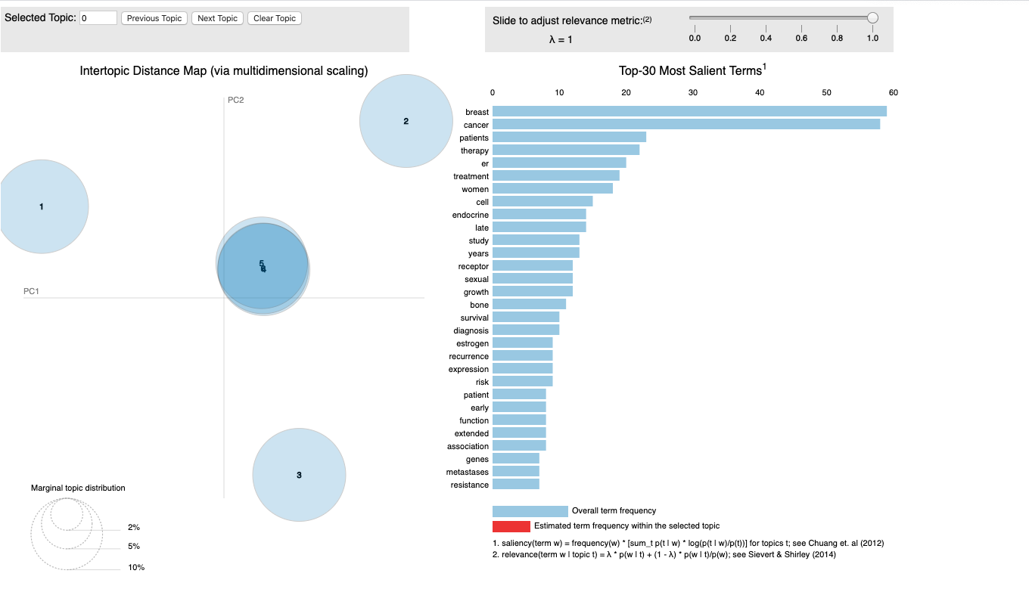
Topic modelling – 3

Slide 14
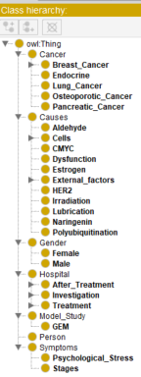
Classes identified
Cancer
Causes
Gender
Hospital
Symptoms
Person

Slide 15
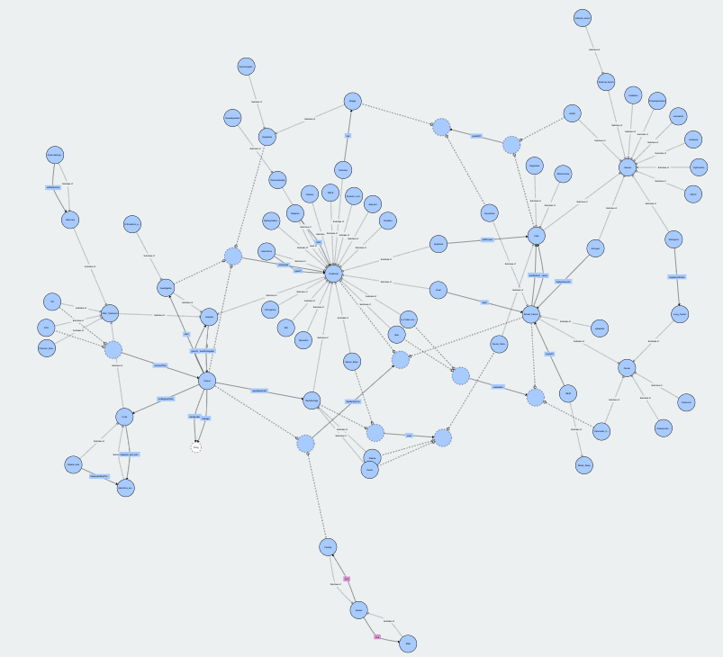
Ontology graph

Slide 16
conclusion
Ontology is beneficial in multiple ways
Better and clear understanding of the concepts associated with data
Easy identification of relationship existing within the data
Tremendous scope of improvement and growth
Good learning experience

Slide 17



